Slide 1
OLYMPICS SPORTS ANALYSIS

Slide 2
Project Overview
This project involves performing an in-depth sports analysis to gain actionable insights into Games trends, Event Participants, Sports trends, Regional trends.
Using the provided ER diagram and answering specific exploratory data analysis (EDA) and Power BI questions, the goal is to identify opportunities to optimize meaningful Insights.
Evaluate on Type of Olympic Sports Analysis, overtime trend on events etc….

Slide 3
MECE Breakdown for Sports Data.
Athlete Analysis
Sports Analysis
Games Analysis
Sports Trend
Gender Analysis
Regional Analysis
Age Distribution
Events Analysis
Regional Dominance
Participant pattern
Medal Analysis
Event Level Trend
Medal Trends
Level Analysis
Participants in different sports, games, evolved overtime
Evaluating different medals across regions and their excellence overtime
Host city impact
Comparison b/w participants who won medals across different regions and gender
Medal distribution
Analysis on popularity over time and over decades.
Comparison b/w Male and female
Analysis on which sport got which medal
Decadal Trend
Evaluate game trends over decades
Compare age distribution of athletes across different games
Analyse the no of participants across regions
Examine the geographic spread of host cites and their benefits
Evaluate the number of events held for men, women
Evaluate who won in more than one event
Evaluate highest number of medals
Analysis on age, gender, country, awards etc….
Performance Evaluation
Participants Analysis
Demographic Insights

Slide 4
Tools Used: SQL: Data extraction and aggregation. Excel: Initial data exploration and validation. Power Bi: Dashboard creation and visualization.

Slide 5
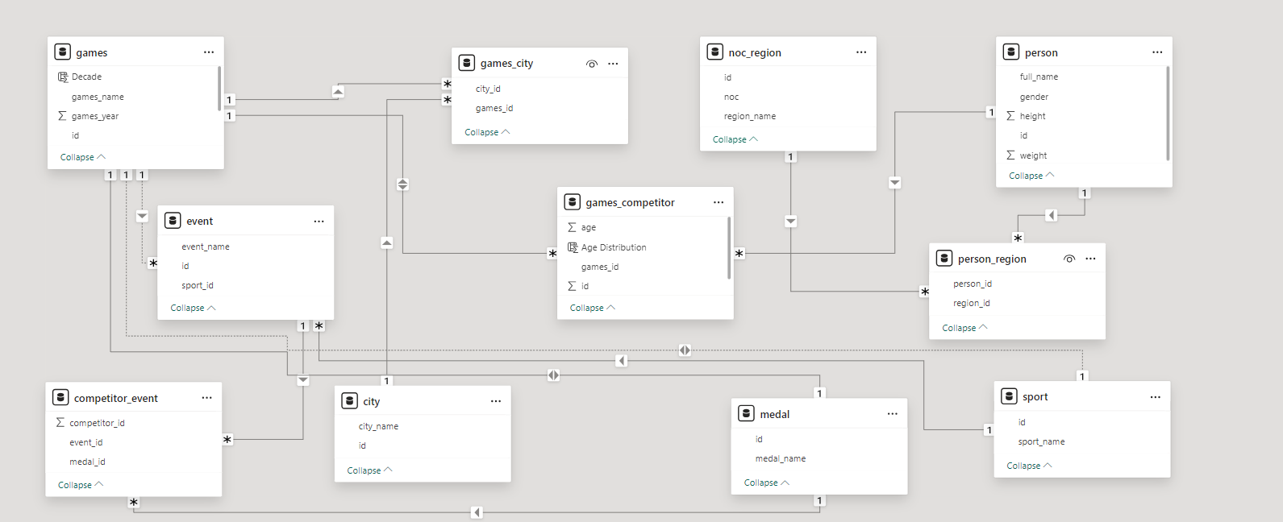
ER-DIAGRAM

Slide 6
EDA Analysis

Slide 7
Q1. Are there any trends or patterns in the frequency of hosting Olympic Games?
Some cities, like London, Los Angeles, and Paris, have hosted multiple times, indicating their prominence in global sports infrastructure and historical significance.
Hosting was more frequent in Europe during the early 20th century, with a gradual shift to other continents in the 21st century.
Countries in Europe and North America dominate hosting frequency.

Slide 8
Q2. How has the duration of Olympic Games changed over time?
The earliest Olympic Games were short (e.g., 10 days in 18
The duration of the Olympics stabilized to around 16 days starting with the 1936 Berlin Games.96).
Most recent games typically last 15-17 days, allowing for a two-week format aligned with global broadcasting schedules.
The 1908 London Olympics lasted 187 days due to event spread.
The 2020 Tokyo Games faced delays and challenges from the COVID-19 pandemic, but the duration of events remained similar.
Winter Games also follow a similar pattern, typically lasting 14-16 days.

Slide 9
Q3. Are there any notable events or occurrences associated with specific Olympic Games?
The Olympic Games have witnessed numerous notable events and occurrences that have shaped history. These include record-breaking performances, moments of political significance, groundbreaking inclusions (e.g., gender equality milestones), and technological innovations. Each edition of the Games reflects a unique intersection of sports, culture, and societal change, leaving a lasting legacy on the global stage.

Slide 10
Q4. Are there any emerging sports that have been recently added to the Olympics?
Recent Olympic Games have embraced emerging sports, including Gymnastics, Badminton, Judo, skateboarding, surfing, sport climbing, and karate. These additions reflect the evolving interests of younger audiences and global sports culture, ensuring the Olympics stay relevant and inclusive in the modern era.

Slide 11
Q5. How has the popularity of certain sports changed over the years?
The popularity of sports has evolved due to societal trends, technological advancements, and media influence. Traditional sports like athletics and swimming remain popular, while newer sports such as e-sports and extreme sports are gaining traction, reflecting shifting audience preferences globally.

Slide 12
Q6. Are there any sports that are specific to a particular region or culture?
Yes, many sports are deeply rooted in specific regions or cultures
In USA, Uk, France are specific to a particular region.

Slide 13
Q8. Are there any new events that have been introduced in recent editions of the Olympics?
Recent Olympic editions have introduced new events like Gymnastics, Badminton, Judo, Speed skating, etc….
These additions aim to enhance diversity, gender balance, and audience engagement, keeping the Games dynamic and modern.

Slide 14
Q9. Are there any events that have been discontinued or removed from the Olympics?
Several events, such as tug-of-war, cricket, and polo, have been discontinued from the Olympics due to declining popularity, logistical challenges, or lack of global participation. These decisions reflect the evolving focus of the Games on widely recognized and practiced sports.

Slide 15
Q10. Are there any notable trends in the height and weight of participants over time?
EDA reveals notable trends in the height and weight of Olympic participants over time, varying by sport and discipline.
For instance, athletes in sports like basketball and volleyball tend to be taller, while weightlifting shows trends toward higher body weight.
These variations reflect the physical demands and specialization required for different sports.

Slide 16
Q11. Are there any dominant countries or regions in specific sports or events?
EDA highlights specific countries or regions consistently dominating certain sports
USA excels in swimming and athletics, China leads in table tennis and gymnastics, and European nations dominate soccer and cycling.
These trends reflect historical, cultural, and resource investments in these sports by respective countries

Slide 17
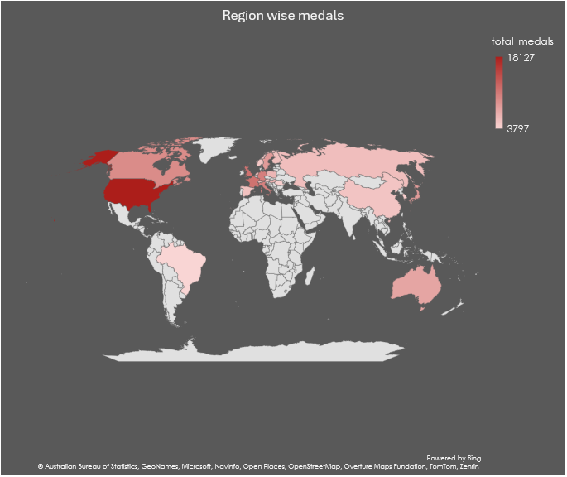
Q13. Are there any countries that consistently perform well in multiple Olympic editions?
EDA reveals countries like the USA, China, and Russia consistently performing well across multiple Olympic editions.
Their success stems from strong sports infrastructure, investment in athlete development, and diverse participation across various events.

Slide 18
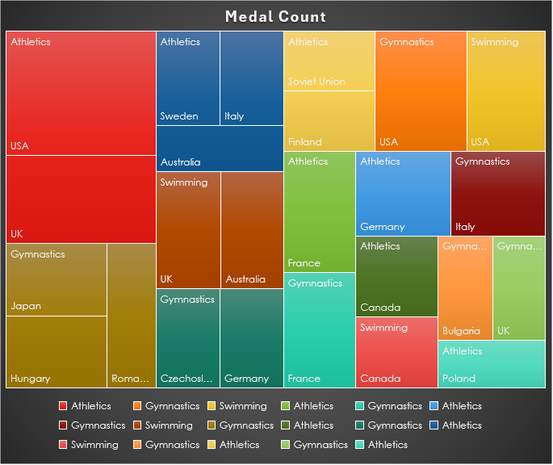
Q14. Are there any sports or events that have a higher number of medalists from a specific region?
EDA shows that certain sports have a higher number of medalists from specific regions.
Athletics in USA and UK have got the highest Medal count.

Slide 19
Q16. Are there any regions that have experienced significant growth or decline in Olympic participation?
EDA shows significant regional trends in Olympic participation, with regions like Africa and Asia experiencing substantial growth due to improved infrastructure and athlete development.
USA have the significant growth rate among different countries.

Slide 20
Q18. Are there any regions that have had a notable impact on the overall medal tally?
Identified regions with consistently high medal tallies.
Highlight regions that dominate specific sports or decades
Analyze trends over time to see whether any regions are emerging or declining in influence.

Slide 21
Power bi Analysis

Slide 22
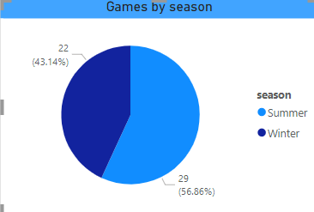
Q1. How many Olympic Games have been held in each season (Summer vs. Winter)?

Slide 23
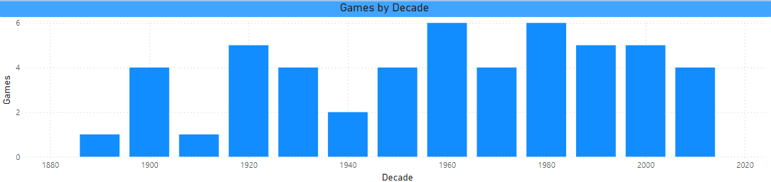
Q2. What is the distribution of games across different decades?

Slide 24
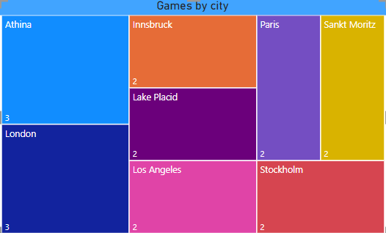
Q3. Which cities have hosted the most Olympic Games?

Slide 25
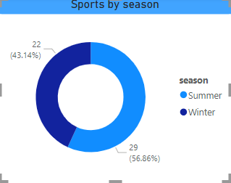
Q4. What is the distribution of sports between the Summer and Winter Olympics?

Slide 26
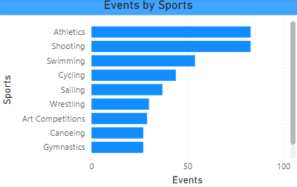
Q5. Which sports have the highest number of events in the Olympics?

Slide 27
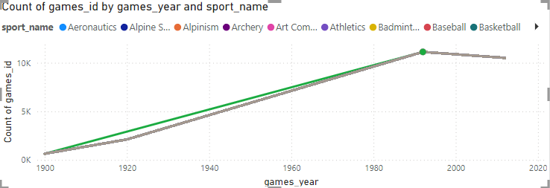
Q6. How has the participation in each sport evolved over time?

Slide 28
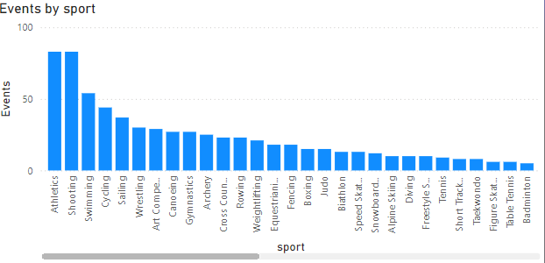
Q7. How many events are there in each sport?

Slide 29
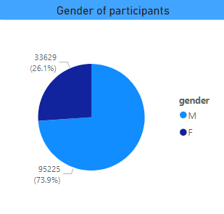
Q8. What is the distribution of events by gender (Men, Women, Mixed)?

Slide 30
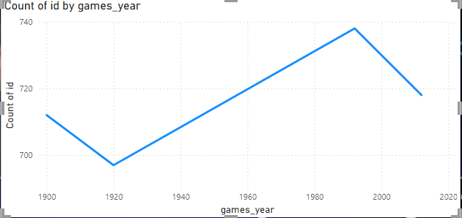
Q9. How has the number of events changed over time?

Slide 31
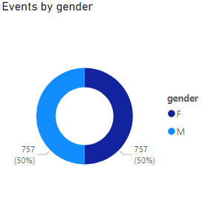
Q10. What is the distribution of participants by gender?

Slide 32
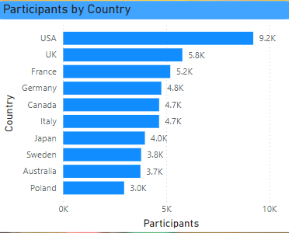
Q11. Which countries have the highest number of participants in the Olympics?

Slide 33
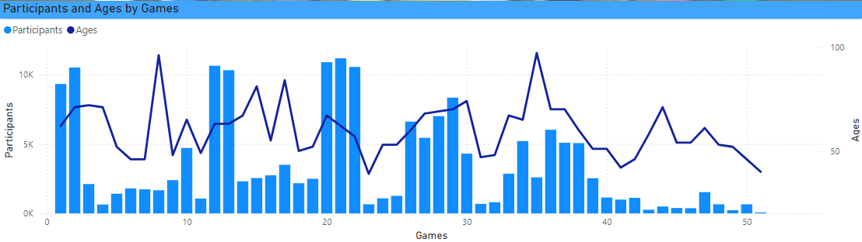
Q12. How does the age distribution of participants vary across different games?

Slide 34
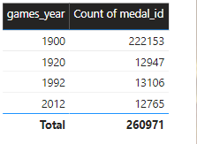
Q13. How many medals have been awarded in each Olympics?

Slide 35
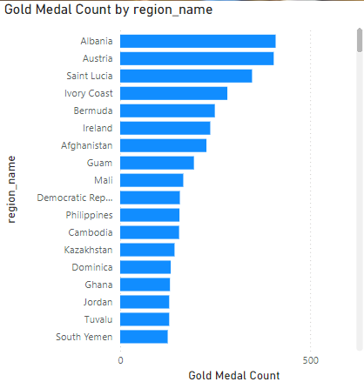
Q14. Which countries have the highest number of gold medals?

Slide 36
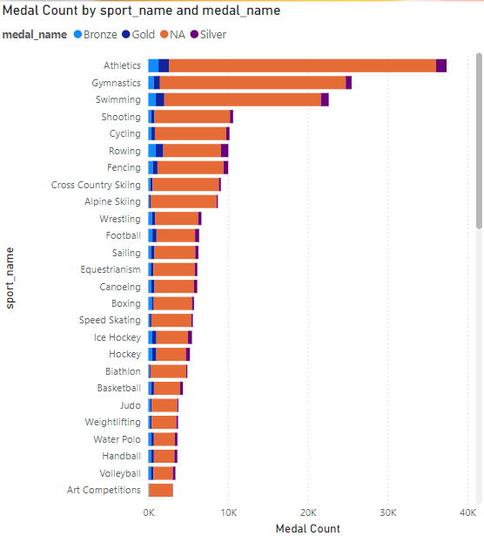
Q15. How does the medal distribution vary across different sports?

Slide 37
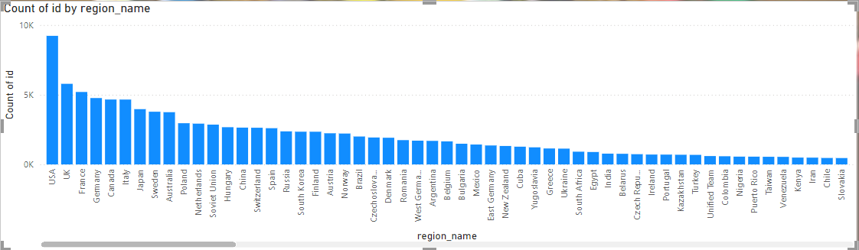
Q16. How many regions or NOCs participate in each Olympic Games?

Slide 38
Q17. Which regions have the highest number of participants in the Olympics?

Slide 39
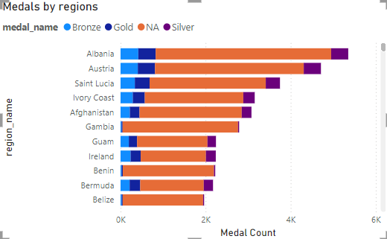
Q18. What is the distribution of medals among different regions?

Slide 40
Summary
The Olympics include a wide range of sports, divided into categories such as aquatics, athletics, team sports, and individual sports.
An increasing number of countries and athletes participate in the Olympics.
Representation has grown across continents, with emerging nations gaining visibility in global sports.
Certain countries dominate specific sports (e.g., the U.S. in swimming, Kenya in long-distance running).
Medal counts often correlate with a nation's investment in sports infrastructure and athlete development programs.
This type of analysis typically informs decisions on policy, athlete training, and investments in sports infrastructure.

Slide 41
Thank you

